Slide 1
Lucene, Solr and HW#4

Slide 2
What is Lucene
High performance, scalable, full-text search library
Basically one adds documents to Lucene which creates an inverted index
  A document is defined as a collection of fields
  Lucene includes flexible text analysis including tokenizers and filters
Lucene does NOT include crawlers or explicit searching of documents
  Searching the index must be implemented elsewhere
100% Java, no dependencies
Offered by the Apache Software Foundation

Slide 3
What is Solr
A full text search server based on Lucene
Communicates with Lucene via XML/HTTP, JSON Interfaces
Flexible data schema to define types and fields
Output includes highlighting matches
Configurable advanced caching
Index Replication
Extensible Open Architecture, Plugins
Web Administration Interface
Written in Java5, deployable as a WAR

Slide 4
Top-Level Overview of Lucene/Solr
HTML
Indexer
Webapp
Document
super_name: Mr. Fantastic
name: Reed Richards
category: superhero
powers: elasticity
Query Response
(matching docs)
Query
(powers:agility)
http://solr/update
http://solr/select
admin
update
select
XML response writer
Solr
JSON response writer
Servlet Container
XML Update Handler
Standard request handler
CSV Update Handler
Custom request handler
Lucene

Slide 5
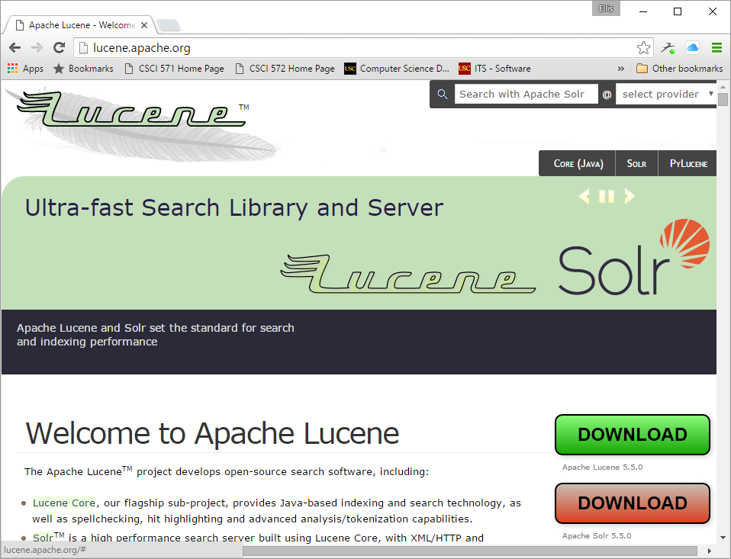
Download
Lucene
Download
Solr
You only need to download Solr

Slide 6
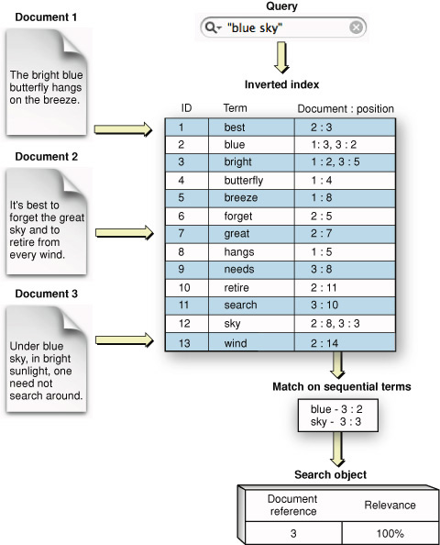
Lucene Internals - Positional Inverted Index
takes documents, parses them into terms
and builds a positional inverted index;

Slide 7
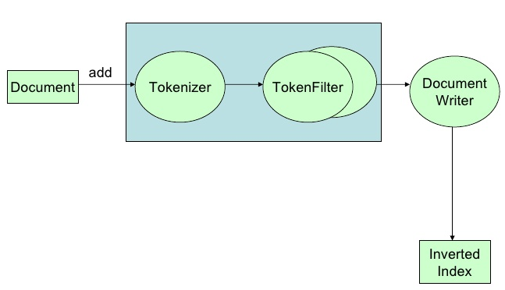
Lucene Indexing Pipeline
Analyzer
Analyzer : create tokens using a Tokenizer and/or applying Filters (Token Filters)
  Splits words at punctuation characters, removing punctuation. However, a dot that's not followed by whitespace is considered part of a token.
  Splits words at hyphens, unless there's a number in the token, in which case the whole token is interpreted as a product number and is not split.
  Recognizes email addresses and internet hostnames as one token.

Slide 8
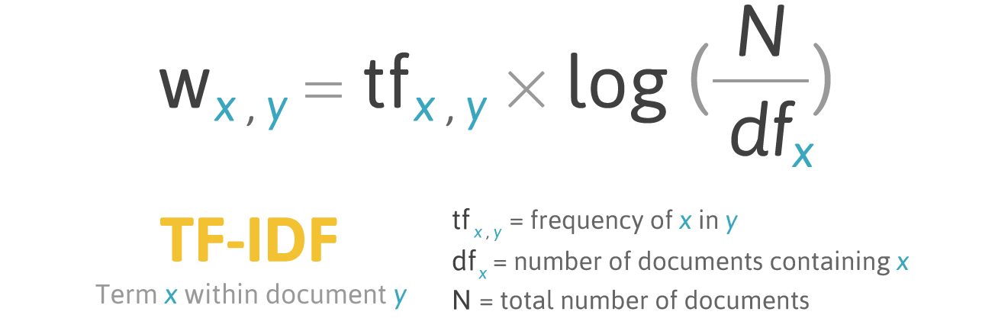
Two Lucene Scoring Concepts
TF – IDF & cosine similarity
Lucene scores using a combination of TF-IDF and vector closeness
1
TF - IDF = Term Frequency X Inverse Document Frequency
cosine-similarity(query_vector, document_vector) = V(q) * V(d)/|V(q)|*|V(d)|
where V(q)*V(d) is the dot product of the weighted vectors and |V(q)|, |V(d)|
are the Euclidean norms of the vectors (square root of the sum of squares)
for details see
https://lucene.apache.org/core/4_0_0/core/org/apache/lucene/search/similarities/TFIDFSimilarity.html
2

Slide 9











Solr in Production
Includes support for
Sharding
Load balancing
replication
Incoming Search Requests
A database shard is a horizontal
partition of data in a database
or search engine.
Each individual partition is
referred to as a
shard. Each shard is held on a
separate database server
instance, to spread the load.
Load Balancer
Solr Master
Solr Master
Solr
Shard Request
Shard Request
Load Balancer
Load Balancer
Shard Master
Shard
Shard Master
Shard
Replicant
1..n
shards
Replicant
Replicant
Replicant
Replicant
Replicant
Replicant
Replicant

Slide 10
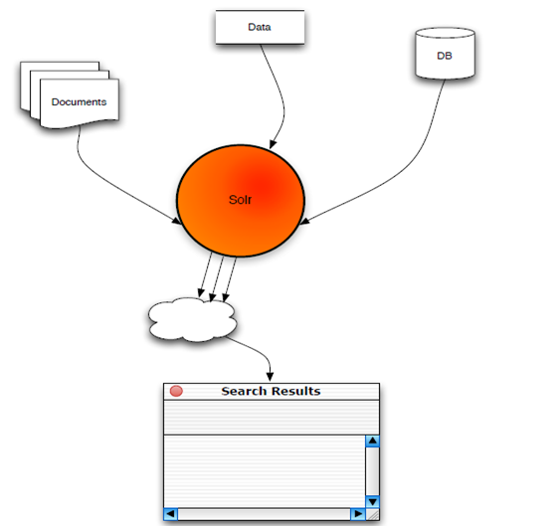
High Level Overview
there is a Solr server
which accepts queries
in the form of http
requests and returns
results as JSON strings
Lucene/Solr

Slide 11
Solr Request and Result
http://localhost:8983/solr/select?q=video&start=0&rows=2&fl=name,price
<response><responseHeader><status>0</status>
<QTime>1</QTime></responseHeader>
<result numFound="16173" start="0">
<doc>
<str name="name">Apple 60 GB iPod with Video</str>
<float name="price">399.0</float>
</doc>
<doc>
<str name="name">ASUS Extreme N7800GTX/2DHTV</str>
<float name="price">479.95</float>
</doc>
</result>
</response>
status, always 0 in a successful response
QTime, the server-side query time in milliseconds
numFound, the total number of documents matching the query
start, the offset into the ordered list of results
field types in <doc> include str, boolean, int, long, float, double, date, lst, arr
  lst is a named list <lst><int name=“foo”>33</int><int name=“bar”>42</int></lst>
  arr is an array <arr><int>33</int><int>42</int></arr>
multivalued fields are returned in an <arr> element.

Slide 12
How to Start Solr
Complete installation instructions can be found at
http://lucene.apache.org/solr/quickstart.html
Once it is installed:
1. Start Solr
java -jar start.jar
2. Index your XML data
java -jar post.jar *.xml
3. Search http://localhost:8983/solr
localhost indicates the Solr server is running locally on port 8983

Slide 13
Querying Data and XML Response
HTTP GET or POST with parameters are used to specify queries
E.g. here are 4 sample queries, some with various parameters
http://solr/select?q=electronics
http://solr/select?q=electronics&sort=price+desc
http://solr/select?q=electronics&rows=50&start=50
http://solr/select?q=electronics&fl=name+price
price and desc are fields
limit results to fields:
name and price
<response>
<lst name="responseHeader">
<int name="status">0</int>
<int name="QTime">1</int>
</lst>
<result name="response" numFound="14" start="0">
<doc>
<arr name="cat">
<str>electronics</str>
<str>connector</str>
</arr>
...
Notes:
Faceted Searching with Apache Solr

Slide 14
Querying Data: Results
The standard response format is XML
JSON is often used as well
<response>
<lst name="responseHeader">
<int name="status">0</int>
<int name="QTime">1</int>
</lst>
<result name="response" numFound="14" start="0">
<doc>
<arr name="cat">
<str>electronics</str>
<str>connector</str>
</arr>
<arr name="features">
<str>car power adapter, white</str>
</arr>
<str name="id">F8V7067-APL-KIT</str>
...
Notes:
Faceted Searching with Apache Solr

Slide 15
Query Types Supported by Solr
Single and multi-term queries
    ex fieldname:value or title: software engineer
+, -, AND, OR, NOT operators are supported
    ex. title: (software AND engineer)
Range queries on date or numeric fields,
    ex: timestamp: [ * TO NOW ] or price: [ 1 TO 100 ]
Boost queries:
    e.g. title:Engineer ^1.5 OR text:Engineer
Fuzzy search : is a search for words that are similar in spelling
    e.g. roam~0.8 => noam
Proximity Search : with a sloppy phrase query. The closer together the two terms appear, higher the score.
    ex “apache lucene”~20 : will look for all documents where “apache” word occurs within 20 words of “lucene”

Slide 16
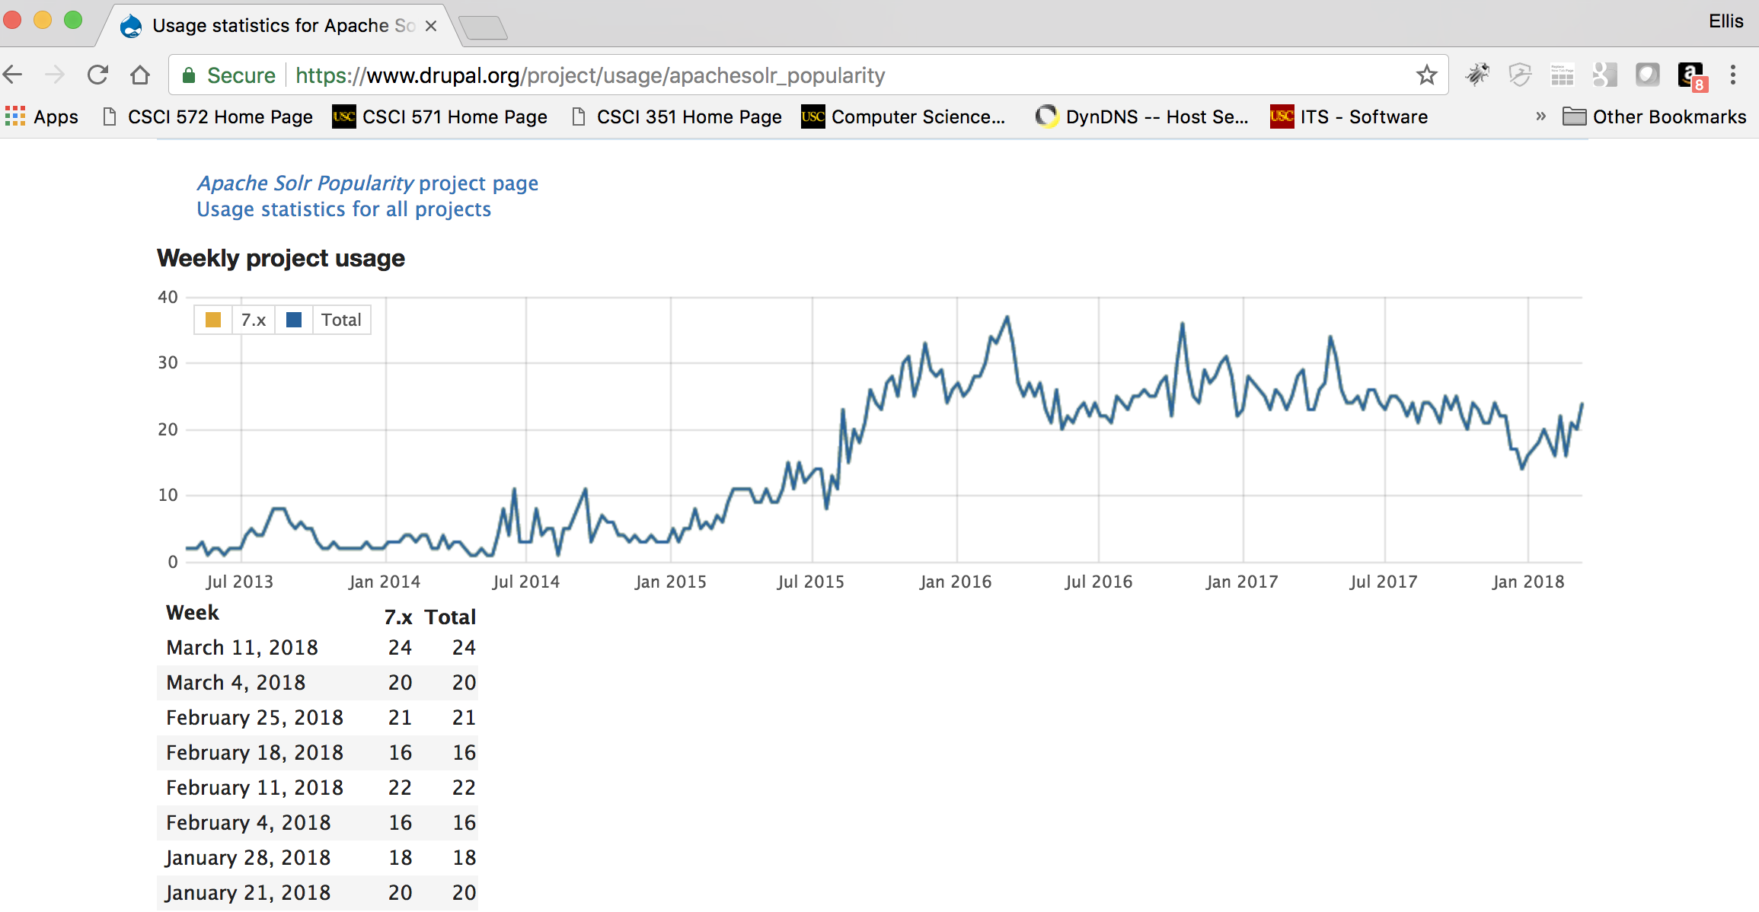
Solr/Lucene is Used WorldWide
Search Engine
  Yandex.ru, DuckDuckGo.com
Newspaper
  Guardian.co.uk
Music/Movies
  Apple.com, Netflix.com
Events
  Stubhub.com, Eventbrite.com
Cloud Log Management
  Loggly.com
Others
  Whitehouse.gov
Jobs
  Indeed.com, Simplyhired.com, Naukri.com
Auto
  AOL.com
Travel
  Cleartrip.com
Social Network
  Twitter.com, LinkedIn.com, mylife.com
Tracking the popularity of Solr

Slide 17
Solr Includes Spell Checking
(you will need this for homework #5)
Not enabled by default, see example config to wire it in
https://cwiki.apache.org/confluence/display/solr/Spell+Checking
Uses file or index-based dictionaries for spell correction
Supports pluggable distance algorithms:
  Levenstein alg: https://en.wikipedia.org/wiki/Levenshtein_distance
  JaroWinkler alg: , https://en.wikipedia.org/wiki/Jaro%E2%80%93Winkler_distance
http://wiki.apache.org/solr/SpellCheckComponent is a full discussion of the spell checking abilities of Solr

Slide 18
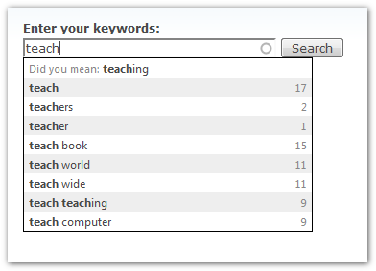
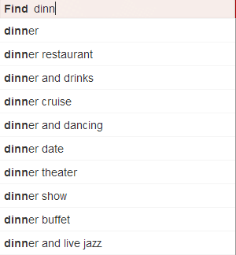
Solr Includes Autosuggestion
(you will need this for homework #5)
https://wiki.apache.org/solr/Suggester

Slide 19
HW#4 Exercise
There are several components to this homework; you will possibly not need all of them;
1. Installing Ubuntu on Windows
2. Installing Solr
3. Using Solr to Index a web site
4. The actual exercise - comparing ranking algorithms
5. What to submit
6. Grading guidelines

Slide 20
What you will need to do
SUMMARY (1 of 2)
If you are using Windows, you will have to install Ubuntu on your machine
  if you have a Mac, skip to step 2
  Solr requires a Unix platform
  first you must download and install Oracle's VirtualBox, free software that will permit you to install Ubuntu on your Windows device
  second you will download and install Ubuntu within Virtualbox
Download and install the current release of Solr
  there is a Quick Start Guide to help you at http://lucene.apache.org/solr/quickstart.html
  the Solr server should be started; to check that it is running look at
  http://localhost:8983/solr
Download the reference news website you are responsible for
  3 news websites are located on Google drive and are accessible using
  https://drive.google.com/open?id=1fEW7H29PEt7SO_dMUNK-JTHgfKAF15Ds

Slide 21
What you will need to do
SUMMARY (2 of 2)
Import the news website web pages you are responsible for into Solr
  There are only three new websites, use your USC ID to determine which one
Using your laptop install or use an existing web server to create a website
  Macs (I believe) have Apache pre-installed
  in your website create a web page that looks like a Google query box
  in your website write a program that takes a query and sends it to Solr
  in your website write a program that accepts the results from Solr and displays them as a web page
Run the set of 8 queries at the end of SolrExercise.pdf
  save the top ten results for each of the eight queries
Use the NetworkX library, the downloaded web pages and Jsoup library to create a network graph of the downloaded web pages
  use the PageRank function from NetworkX to create a file, pagerankFile.txt that contains individual page ranks for every downloaded web page
  install the pagerankFile in Solr and direct Solr to use it on queries
Run the set of 8 queries at the end of SolrExercise.pdf
  save the top ten results for each of the eight queries
compare the two sets of results and describe any overlap

Slide 22
Step 1: Ubuntu with VirtualBox
VirtualBox is an open source, freely available Windows application (it also runs on other platforms) that lets you run multiple operating systems on your single machine
  E.g. run Windows on a Mac, run Linux on Windows
  Major supported operating systems include: Windows NT 4.0, Windows 2000, Windows 8, Windows 10, DOS Windows 3.x, Linux, Solaris, FreeBSD, OpenBSD
Ubuntu is a Linux-based operating system distributed on personal computers, smartphones and network servers. It uses Unity as its default desktop environment
Solr requires a Unix environment to run, so step 1 is required if you plan to use your Windows laptop

Slide 23
Step 1: Setting Up Ubuntu with VirtualBox
Download the free version of VirtualBox for Windows machines
  Instructions can be found here
  http://www-scf.usc.edu/~csci572/2018Fall/hw4/UbuntuVirtualBoxFinal.pdf
Download the Ubuntu 64-bit version
Run VirtualBox and select your Ubuntu version as the New Application
Set various parameters
Install Ubuntu and you should be ready to run

Slide 24
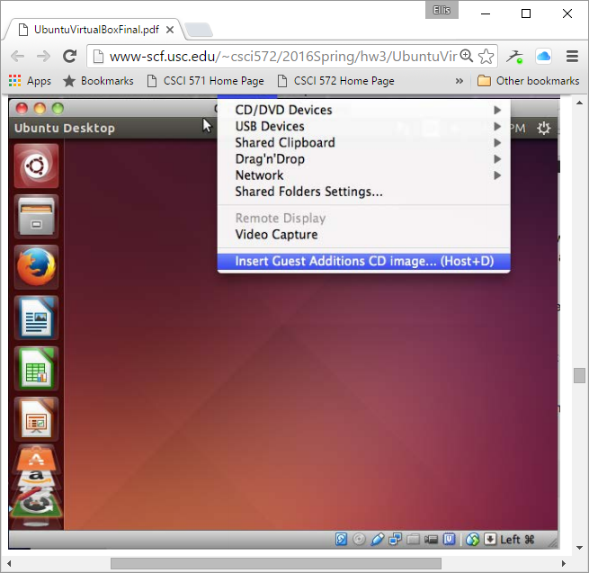
Your Ubuntu/Unity Desktop
Built-in applications
including
Firefox browser

Slide 25
Step 2: Installing Solr
Solr is an open source enterprise search server based on the Lucene Java search library
Instructions for downloading and installing Solr can be found here
  http://lucene.apache.org/solr/quickstart.html
Lucene is a fast, high performance, scalable search/information retrieval library
  Initially developed by Doug Cutting (Also author of Hadoop)
  it provides for Indexing and Searching of documents
  produces an Inverted Index of documents
  Provides advanced Search options like synonyms, stopwords, based on similarity, proximity.
http://lucene.apache.org/ is the main page for both Lucene and Solr

Slide 26
Downloading Your Data Set of Web Pages
We have created a reference set of web pages for all news websites and placed them on Google drive
Below is a URL that will give you access to these data sets
The files are:
  latimes.zip
  mercurynews.zip
  nypost.zip
Download only the zip file you are responsible for
  Check your USC ID against the list in the exercise
here is the URL
  https://drive.google.com/open?id=1fEW7H29PEt7SO_dMUNK-JTHgfKAF15Ds

Slide 27
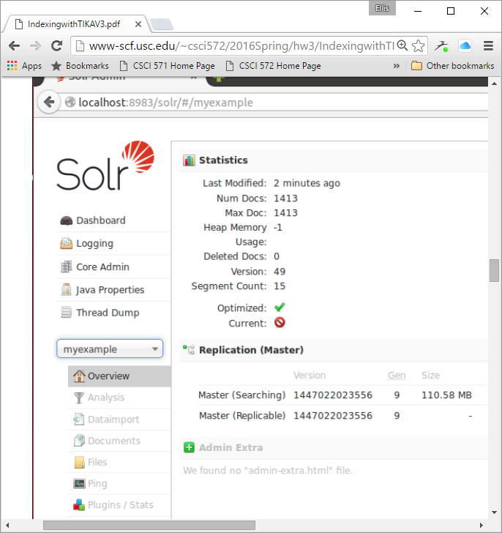
Step 3: Use Solr to Index a Web Site
start the Solr server
start a new Solr core
Use Tika to import your saved files
Use the Solr interface to check that the files have been properly indexed
Note the URL:
localhost:8983/solr/#/myexample
1413 docs successfully
indexed

Slide 28
Step 4:
Comparing Search Engine Ranking Algorithms
You should download the reference files for the news website you are responsible for;
You should install Solr as described previously;
Take the web pages from the reference files and index them in Solr, as described in earlier slides
Build a front end to Solr that permits a visitor to enter a query and get matching results
Solr will return the results in JSON format; your server needs to take the results and format them for the user
your web page
with Query Box
and submit button
format query
and send to Solr;
receive results as
XML or JSON,
format and return
to user
process query
return results
Web Browser Your Web Server Your version of Solr

Slide 29
Apache Solr Client APIs
http is the protocol to be used between client applications and Solr
Clients use Solr's five basic operations: query, index, delete, commit, and optimize
JavaScript is the standard client API and there is no package to be installed
  http requests can be sent using XMLHttpRequest
  Solr will respond with JSON output
there is an output format specifically for Python
  See https://cwiki.apache.org/confluence/display/solr/Using+Python
Full list of Solr API clients can be found here
  https://cwiki.apache.org/confluence/display/solr/Client+API+Lineup

Slide 30
Step 4
Here is a PHP client that accepts input from the user in a HTML form, and sends the request to the Solr server. After the Solr server processes the query, it returns the results which is parsed by the PHP program and formatted for display
<?php
// make sure browsers see this page as utf-8 encoded HTML
header('Content-Type: text/html; charset=utf-8');
$limit = 10;
$query = isset($_REQUEST['q']) ? $_REQUEST['q'] : false;
$results = false;
if ($query)
{ require_once('Apache/Solr/Service.php');
// create a new solr service instance - host, port, and corename
// path (all defaults in this example)
$solr = new Apache_Solr_Service('localhost', 8983, '/solr/core_name/');
// if magic quotes is enabled then stripslashes will be needed
if (get_magic_quotes_gpc() == 1)
{ $query = stripslashes($query); }
returning a web page
test for a query
this is the Solr client
library
Solr runs on port 8983
handles quoting of
special characters in
query

Slide 31
PhP Program (2 of 3)
try
{ $results = $solr->search($query, 0, $limit); }
catch (Exception $e)
{ die("<html><head><title>SEARCH EXCEPTION</title><body><pre>{$e->__toString()}</pre></body></html>"); } }
?>
<html> <head> <title>PHP Solr Client Example</title> </head> <body>
<form accept-charset="utf-8" method="get">
<label for="q">Search:</label>
<input id="q" name="q" type="text" value="<?php echo htmlspecialchars($query, ENT_QUOTES, 'utf-8'); ?>"/>
<input type="submit"/>
</form>
<?php
// display results
if ($results)
{ $total = (int) $results->response->numFound; $start = min(1, $total); $end = min($limit, $total); ?>
<div>Results <?php echo $start; ?> - <?php echo $end;?> of <?php echo $total; ?>:</div>
<ol>
send query to Solr
catch any exception
create web page
output
create input text box
create submit button
end form
JSON result string

Slide 32
PhP Program (3 of 3)
<?php
// iterate result documents
foreach ($results->response->docs as $doc)
{ ?> <li>
<table style="border: 1px solid black; text-align: left">
<?php
// iterate document fields / values
foreach ($doc as $field => $value)
{ ?>
<tr>
<th><?php echo htmlspecialchars($field, ENT_NOQUOTES, 'utf-8'); ?></th>
<td><?php echo htmlspecialchars($value, ENT_NOQUOTES, 'utf-8'); ?></td>
</tr>
<?php }
?> </table> </li>
<?php } ?>
</ol>
<?php
} ?> </body> </html>
output consists of a
set of field, value
pairs

Slide 33
Comparing Ranking Algorithms
we have already seen the built-in Solr ranking method
  Based on Lucene
Solr permits alternative ranking algorithms
  to use PageRank we must create pageranks for all web pages in our news website
  to do this we use an open source program called NetworkX
  we need to create the web graph (pages and links) so the PageRank can be determined
  See the following document for a method on extracting links and producing the NetworkX file:
  http://www-scf.usc.edu/~csci572/2018Fall/hw4/ExtractingLinks.pdf

Slide 34
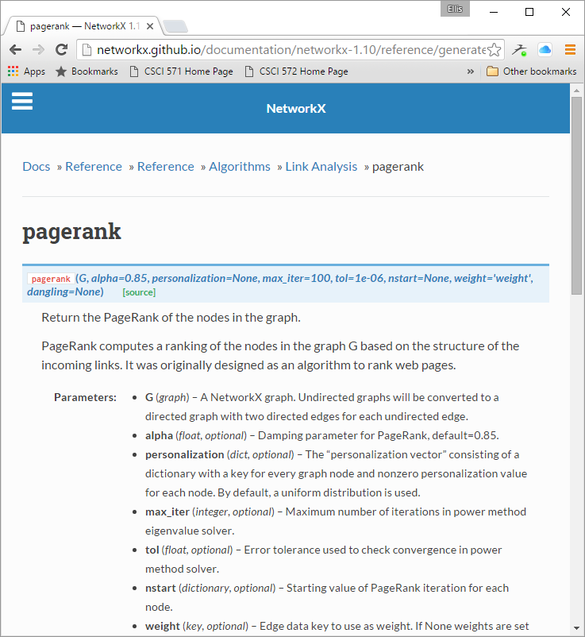
http://networkx.github.io/documentation/networkx-1.10/reference/generated/networkx.algorithms.link_analysis.pagerank_alg.pagerank.html
You are going to use an open source
PageRank algorithm, networkx, located
at URL above;
networkx is a Python program
You need to create a graph that the
PageRank algorithm can work on
Important Parameters:
- a NetworkX graph
- a damping parameter (e.g. 0.85)
- maximum number of iterations
- error tolerance
starting Page Rank value of nodes
(see expansion on next slide)

Slide 35
http://networkx.github.io/documentation/networkx-1.10/_modules/networkx/algorithms/link_analysis/pagerank_alg.html#pagerank
Source code for networkx.algorithms.link_analysis.pagerank_alg
def pagerank(G, alpha=0.85, personalization=None,
max_iter=100, tol=1.0e-6, nstart=None, weight='weight', dangling=None):
Return the PageRank of the nodes in the graph.
Parameters
G : graph: A NetworkX graph.
alpha : float, optional Damping parameter for PageRank, default=0.85.
personalization: dict, optional; By default, a uniform distribution is used.
max_iter : integer, optional Maximum number of iterations in power method eigenvalue solver.
tol : float, optional; Error tolerance used to check convergence in power method solver.
nstart : dictionary, optional Starting value of PageRank iteration for each node.
weight : key, optional; If None weights are set to 1.
Returns
pagerank : dictionary; Dictionary of nodes with PageRank as value
Examples
>>> G = nx.DiGraph(nx.path_graph(4))
>>> pr = nx.pagerank(G, alpha=0.9)

Slide 36
Some NetworkX Operations
Create an empty graph with no nodes and no edges.
>>> import networkx as nx
>>> G=nx.Graph()
add one node at a time
>>>G.add_node(1)
add a list of nodes
>>>G.add_nodes_from([2,3])
add one edge at a time
>>>G.add_edge(1,2)
>>>e=(2,3)
>>>G.add_edge(*e) #unpack edge tuple*
add a list of edges
>>>G.add_edges_from([1,2),(1,3)])

Slide 37
Final Steps
Input to the PageRank algorithm a file containing every document ID and associated with each ID, the IDs that are pointed to by links within the document ID
Output from the PageRank algorithm is a file containing every document ID and its associated PageRank
place this file in solr-5.3.1/server/solr/core_name, call the file external_pageRankFile.txt
add the PageRank field to the schema.xml file
<fieldType name="external" keyField="id" defVal="0" class="solr.ExternalFileField” />
<field name="pageRankFile" type="external" stored="false" indexed="false" />

Slide 38
The Queries
Once both ranking algorithms are working you should input the queries below and compare the results
Query
Donald Trump
LA Lakers
Star Wars
Lebron James
2018 World Cup
North Korea
Hurricane Florence
Paul Allen

